Slide 1

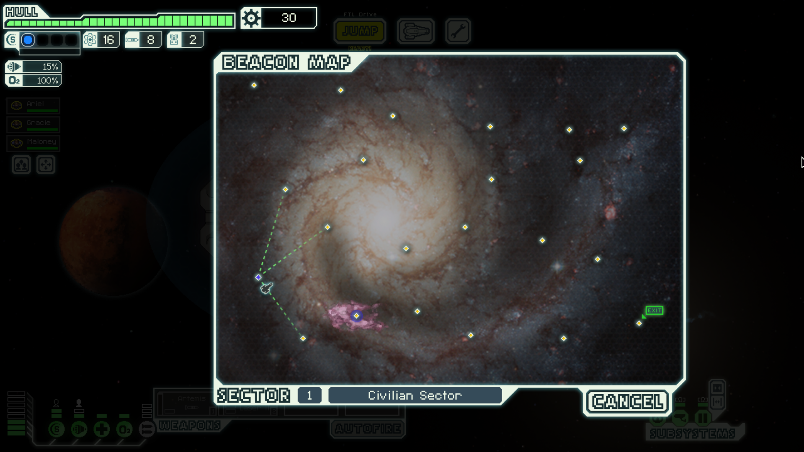
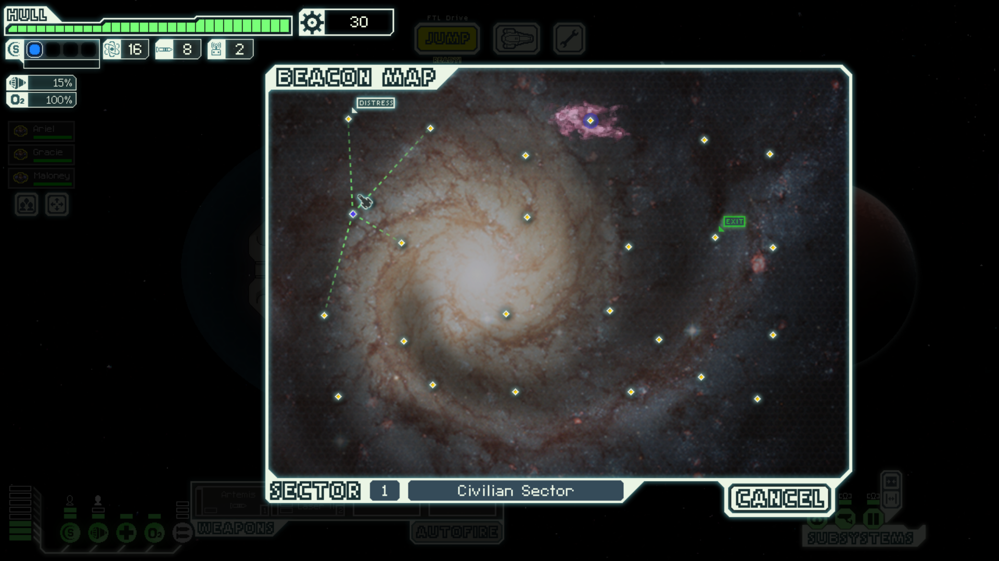


Civilian Sector
1

Slide 2



Slide 3
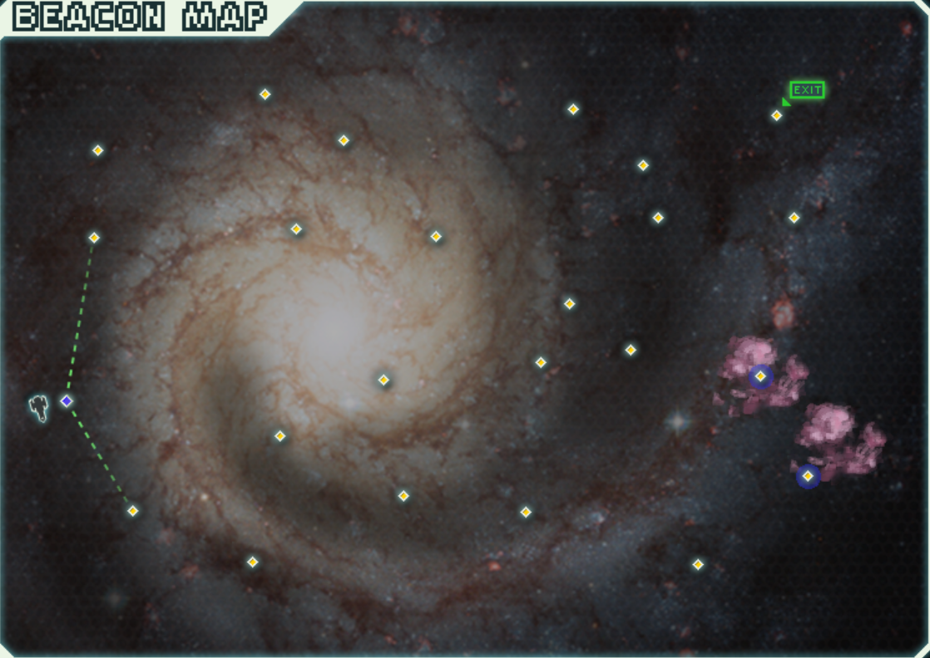
CIVILIAN SECTOR

Slide 4
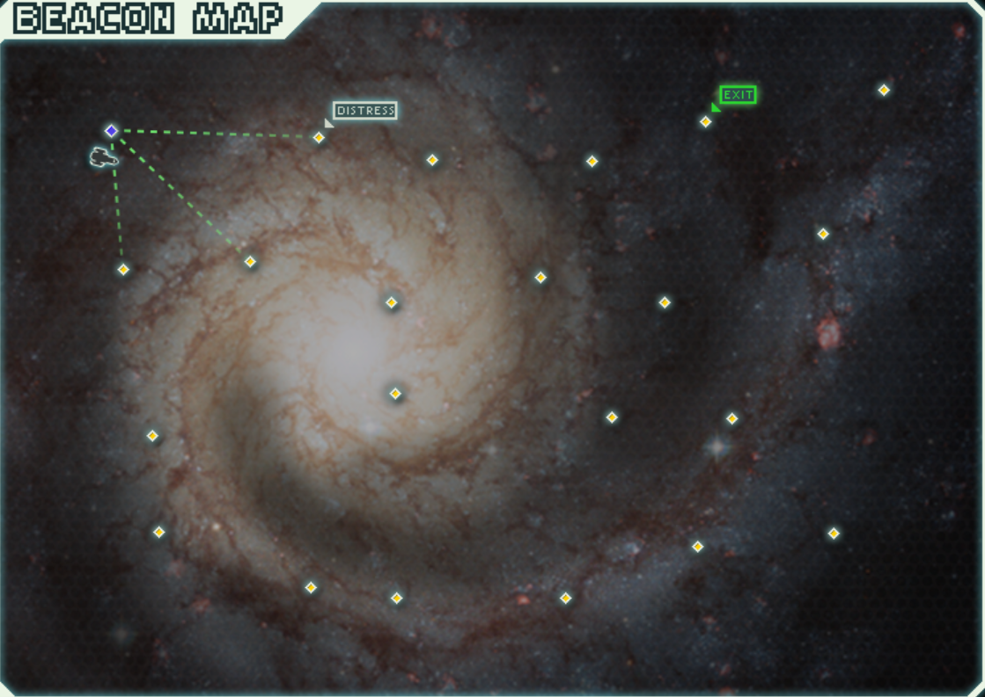
ENGI CONTROLLED SECTOR

Slide 5
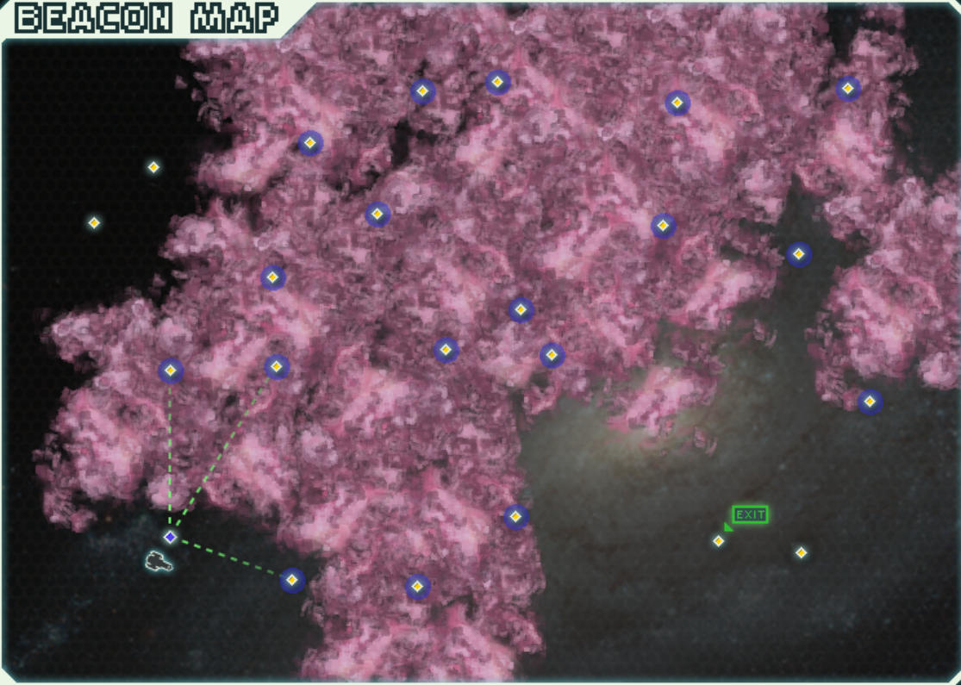
UNCHARTED NEBULA

Slide 6
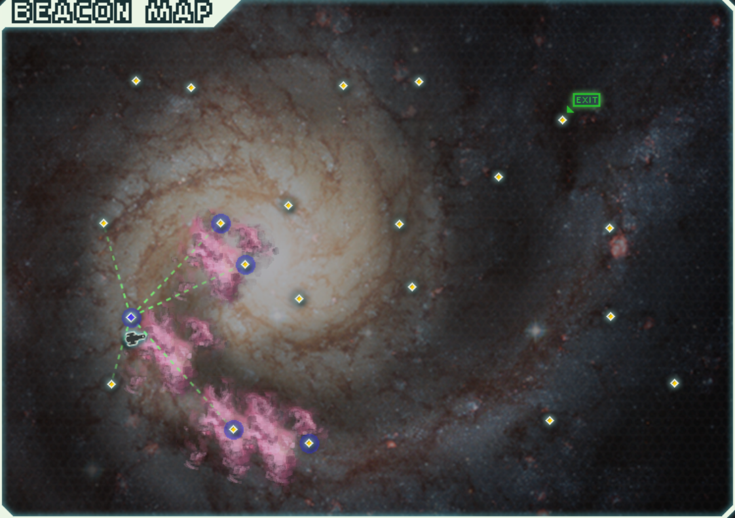
MANTIS CONTROLLED SECTOR

Slide 7
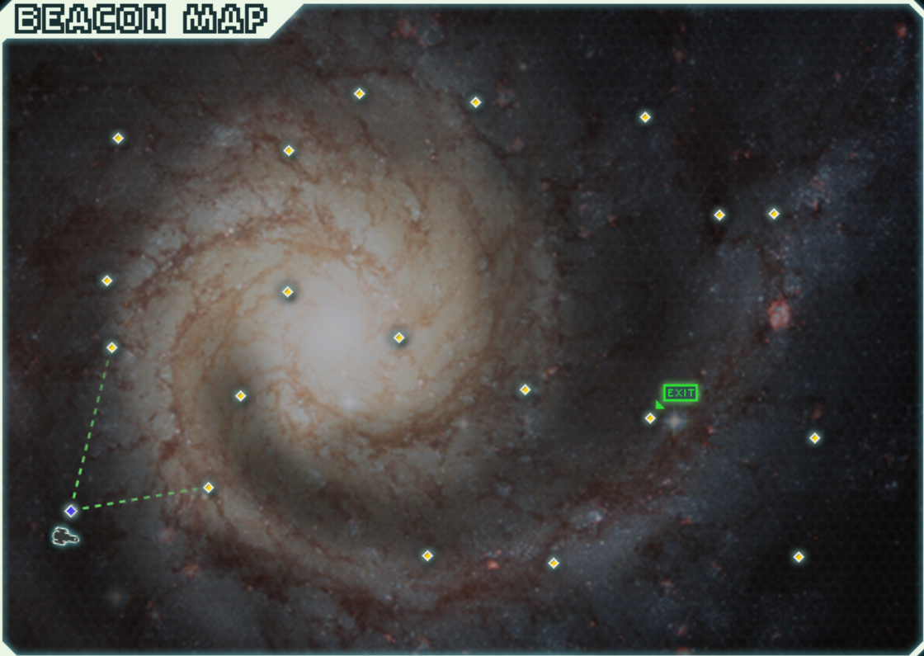
5
ZOLTAN HOMEWORLDS

Slide 8
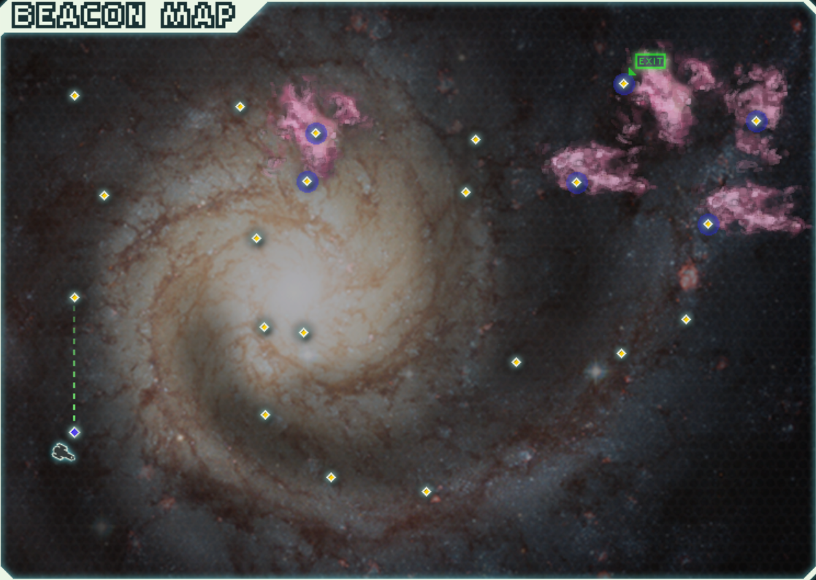
REBEL STRONGHOLD

Slide 9
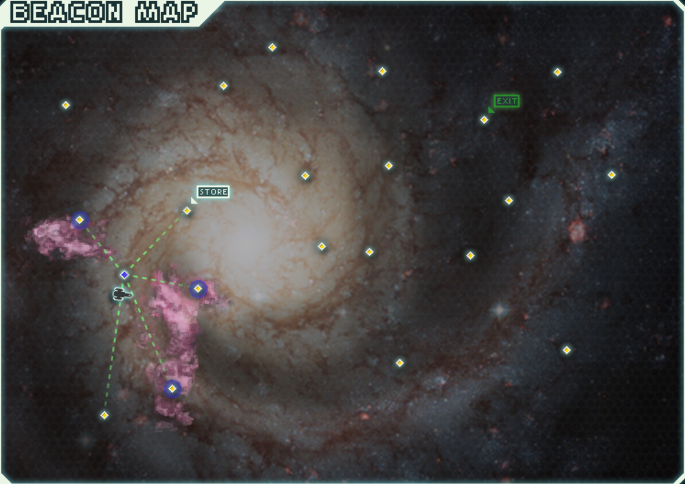
ZOLTAN CONTROLLED SECTOR

Slide 10
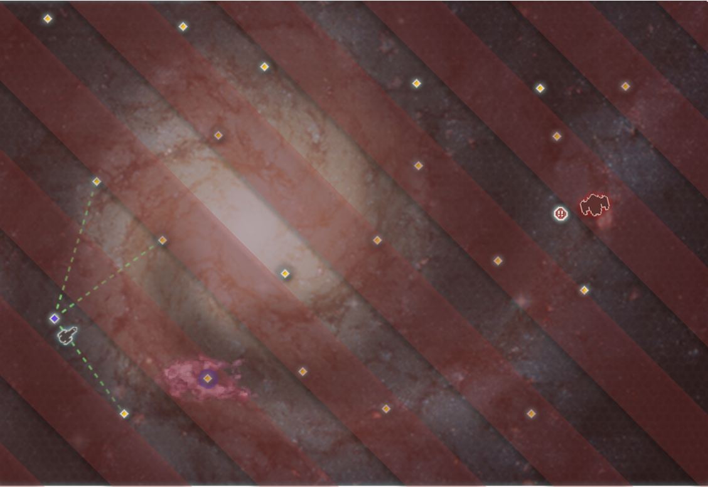
THE LAST STAND

Slide 11
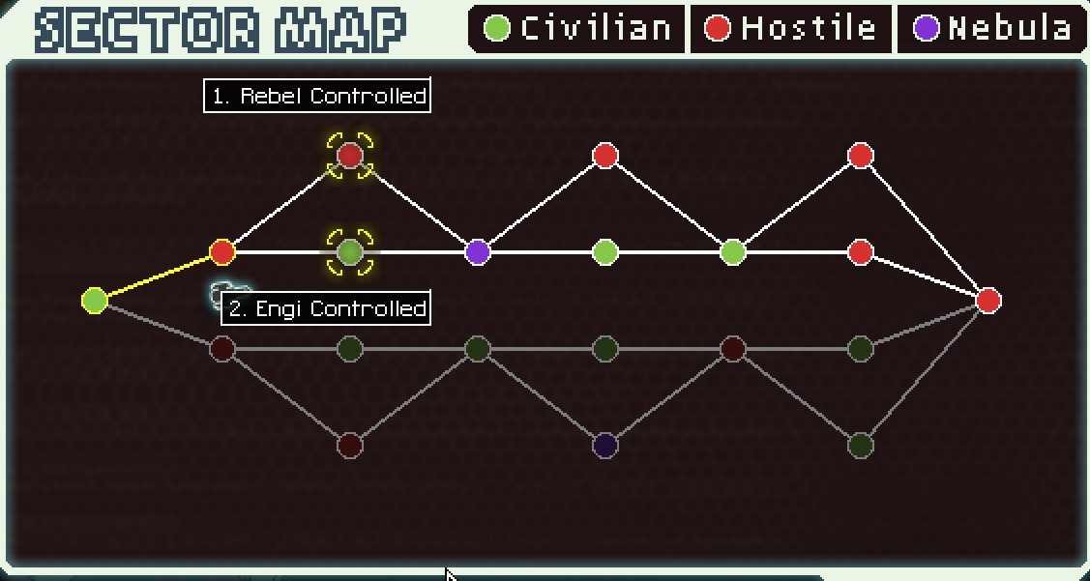


Slide 13






!!
CIVILIAN SECTOR

Slide 14

CIVILIAN SECTOR

Slide 15
ENGI CONTROLLED SECTOR

Slide 16

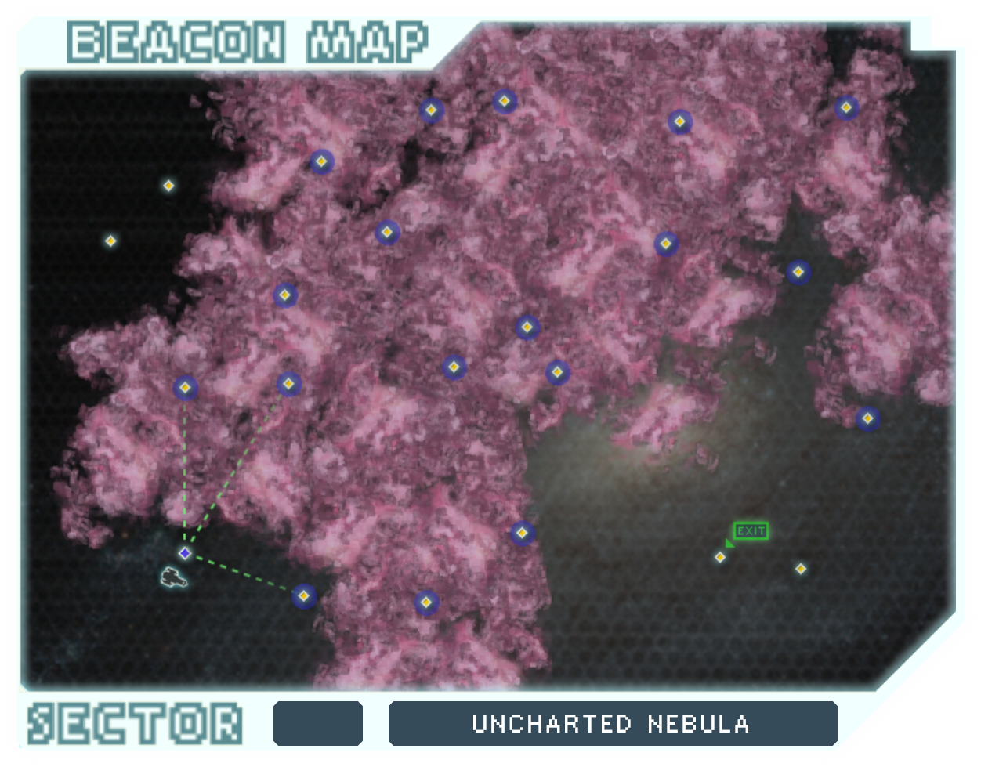


UNCHARTED NEBULA

Slide 17
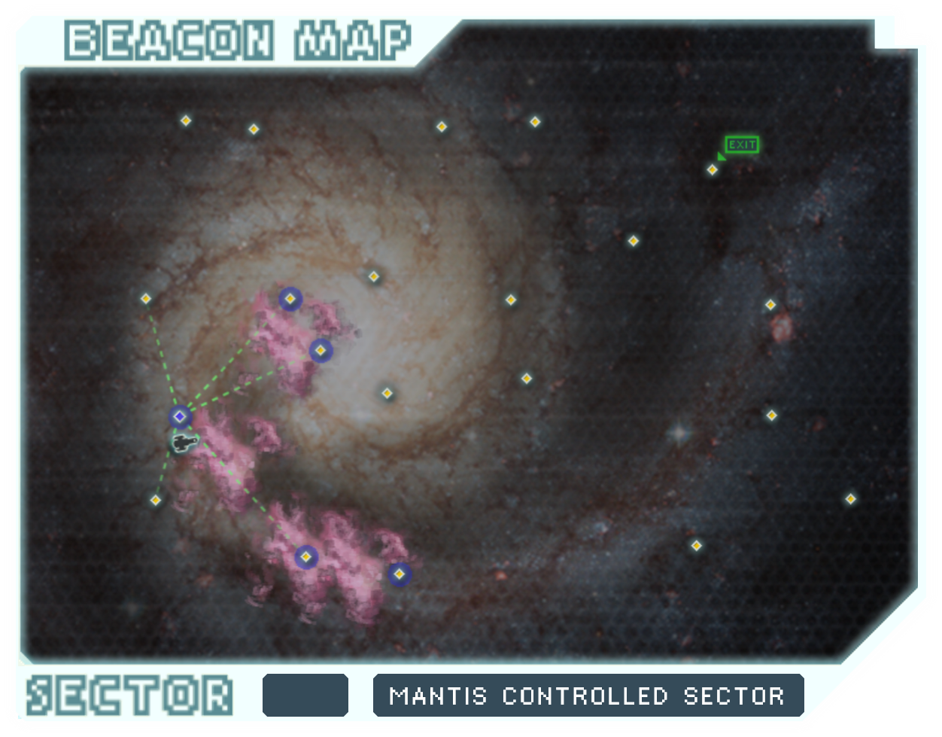

MANTIS CONTROLLED SECTOR

Slide 18
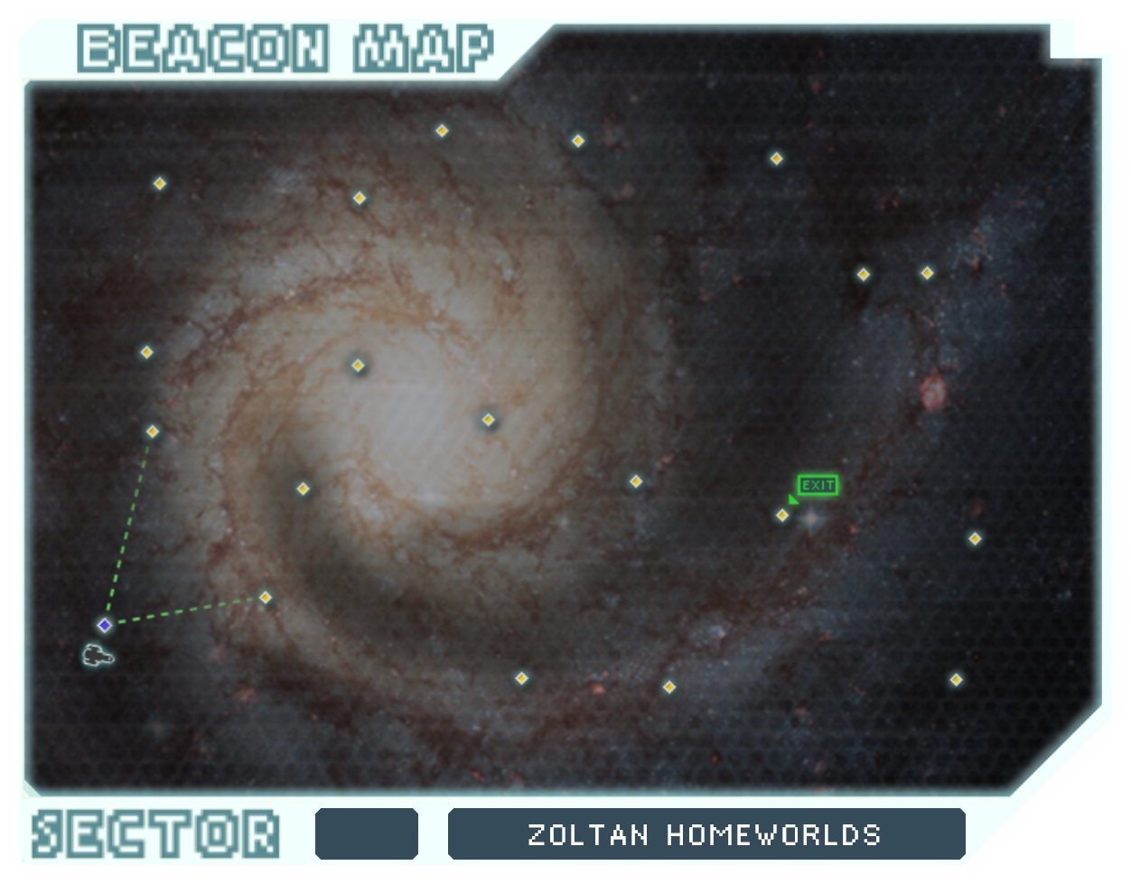
ZOLTAN HOMEWORLDS

Slide 19
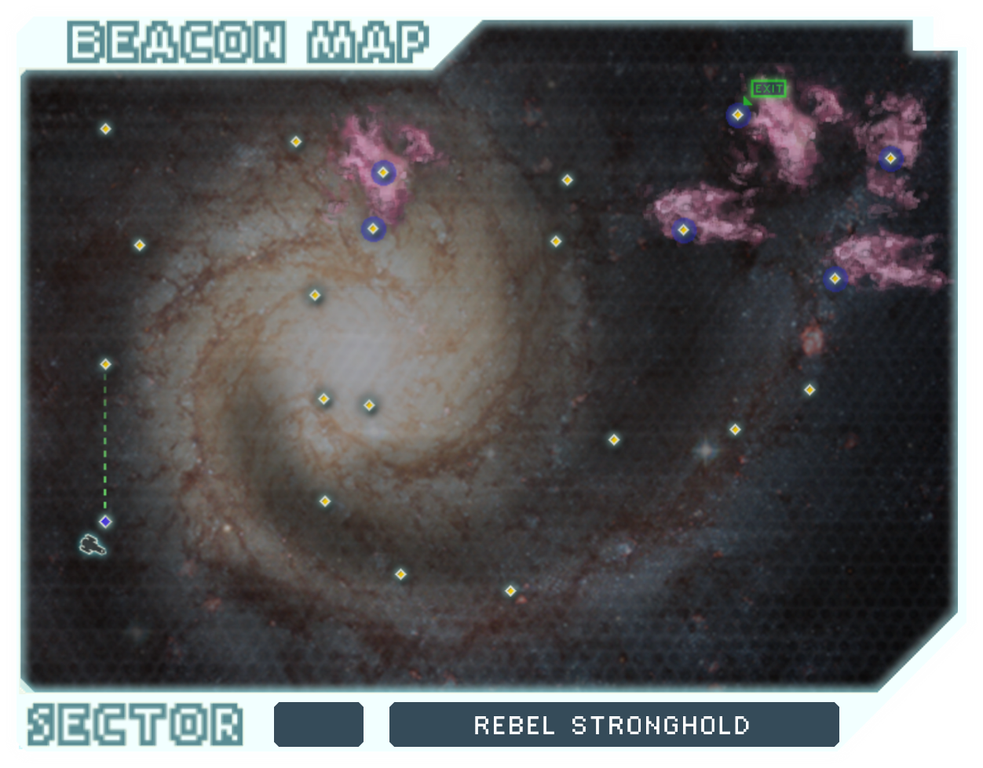
REBEL STRONGHOLD

Slide 20
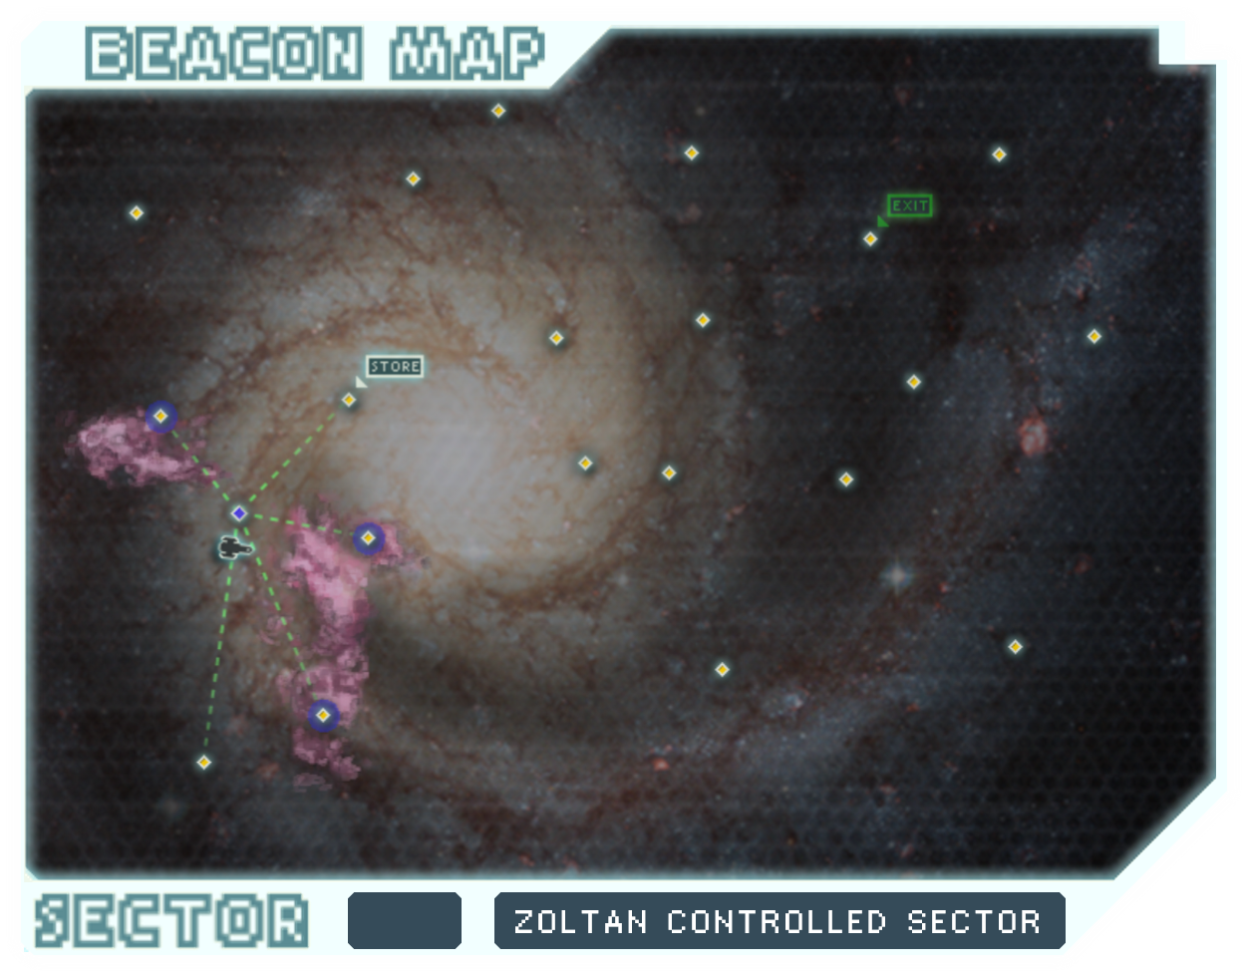
ZOLTAN CONTROLLED SECTOR

Slide 21
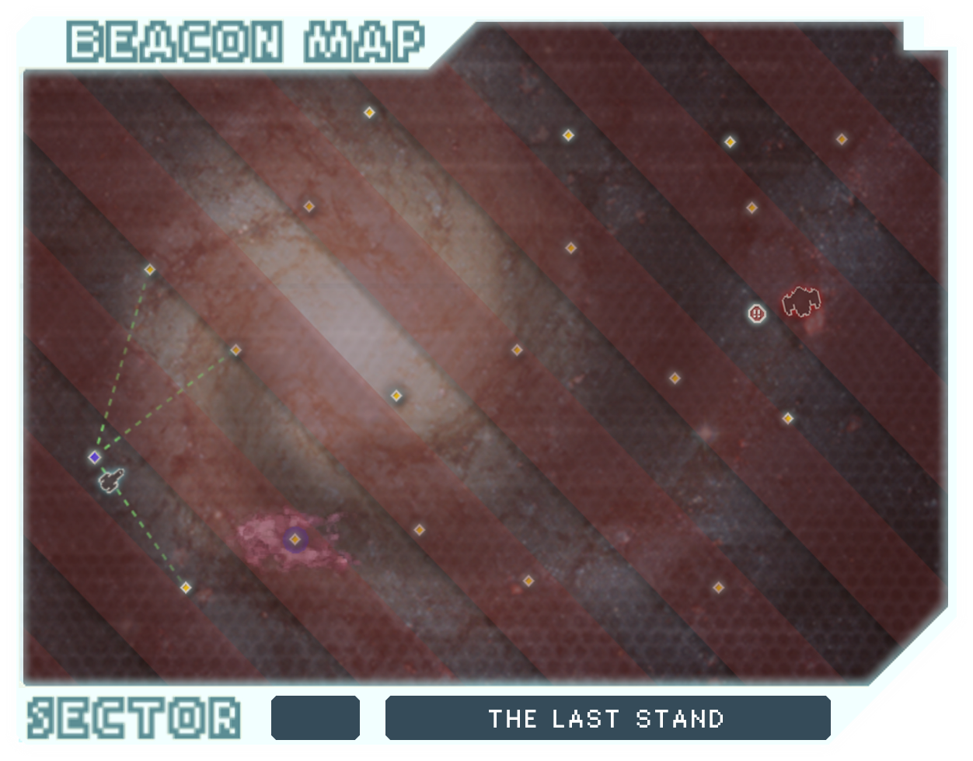
THE LAST STAND

